Slide 1



WELCOME TO THE PRESENTATION
.

Slide 2
Design and Numerical simulation of MEMS Microheater for Gas sensing
Using COMSOL 6.0

Slide 3

WHAT IS MICRO HEATER ?
1..Micro heater is a miniaturized heating system
2.Generates heat through joule heating,ultrasonic or radioactive heating.
3.Temperature of the material depends upon material properties, geometric design.
4.Offer Temperature in excess of 1000 C even upto 1900 C.

Slide 4
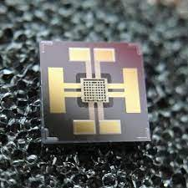
What is Gas Sensor?
1.Gas Sensors are devices that can detect the presence and concentration of various hazardous gases and Vapours.
2. Gas sensors are employed in factories and manufacturing facilities to identify gas leaks, and to detect smoke and carbon monoxide in homes.

Slide 5
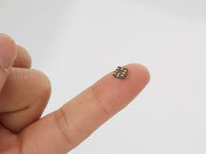
Working of MEMS Microheater.
1.Microheaters involves in conversion of electrical work to high density heat.
2.MEMS microheater are micro-sized heater hotplate.

Slide 6
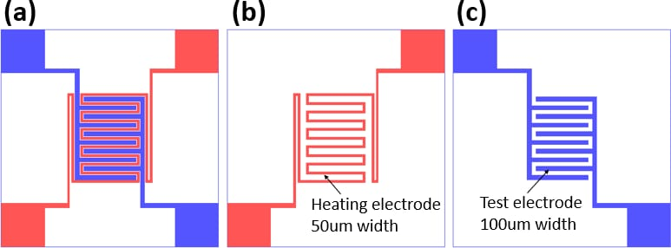
Design of Microheater

Slide 7
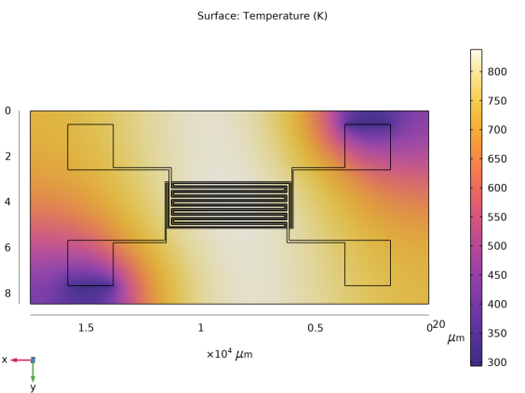
Temperature Distribution

Slide 8
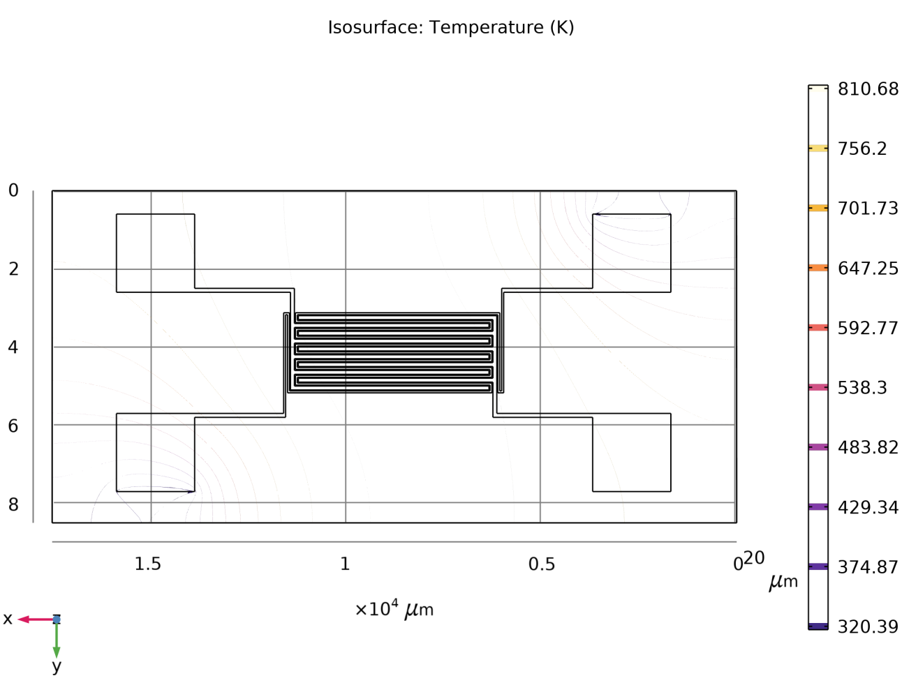
ISOTHERMAL CONTOUR

Slide 9
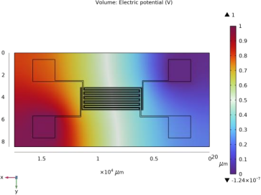
Electric potential Distribution

Slide 10
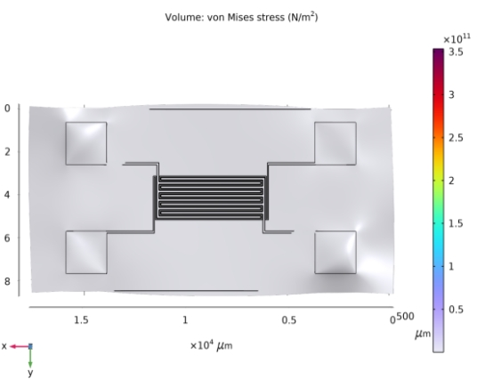
STRESS ANALYSIS

Slide 11
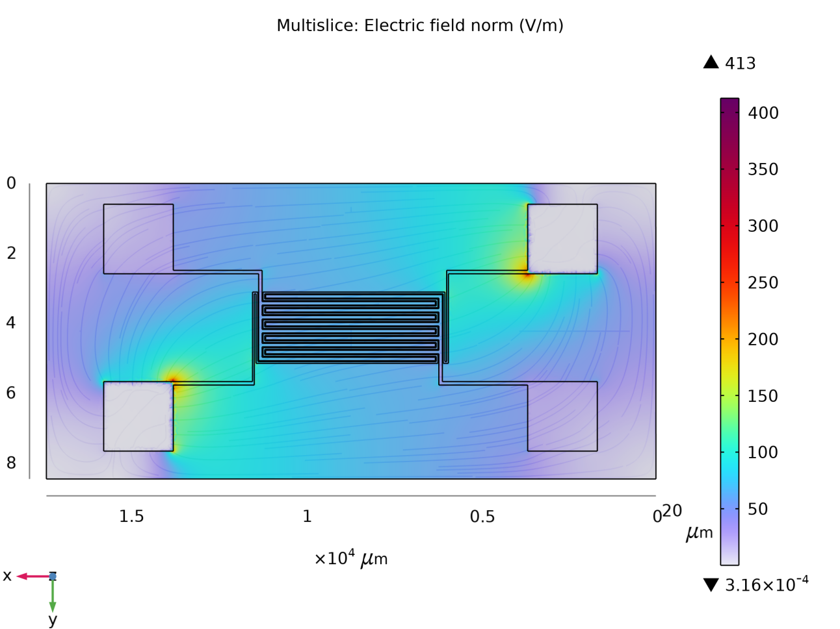
ELECTRIC FIELD NORM(ec)

Slide 12
Why we use Gold?
1.Ambient Nature of gold
2.Have better Uniformity
3.Does not Oxide easily.
4.Good Specific heat capacity.

Slide 13
Advantages of MEMS microheater
1.Reduces power Consumption and Bulkiness.
2.Fast thermal response.
3.High mechanical strength.
4.Long term stability.
5.Well Controlled temperature distribution.

Slide 14
Disadvantages of Conventional Microheater
1.It consume more power.
2.It is big in size when compare to MEMS microheater.
3.It Does not have Better heat uniformity.

Slide 15
Conclusion.
Test and simulation were done for the MEMS microheater,Gold based Microheater provides better results such as Temperature uniformity,Immediate thermal response and it does not oxides.We attain 829 K by applying 1 V. We looking for fabrication this microheater and convert into Gas sensor in future.

Slide 16


